Slide 1
CROSS-REGION PEERING THROUGH TRANSITGATEWAY

Slide 2
STEPS
CREATE 2 VPC . TWO REGION
CREATE 2 TGW . EACH REGION
CREATE 4 TGW ATTACHMENT. 2 FOR VPC, 2 FOR PEERING
CREATE 2 TGW ROUTE TABLE
VPC ROUTE TABLE TO TARGET TGW
CREATE 2 EC2 INSTANCES.ALLOW SG FOR INSTANCE LEVEL
PING PRIVATLY

Slide 3
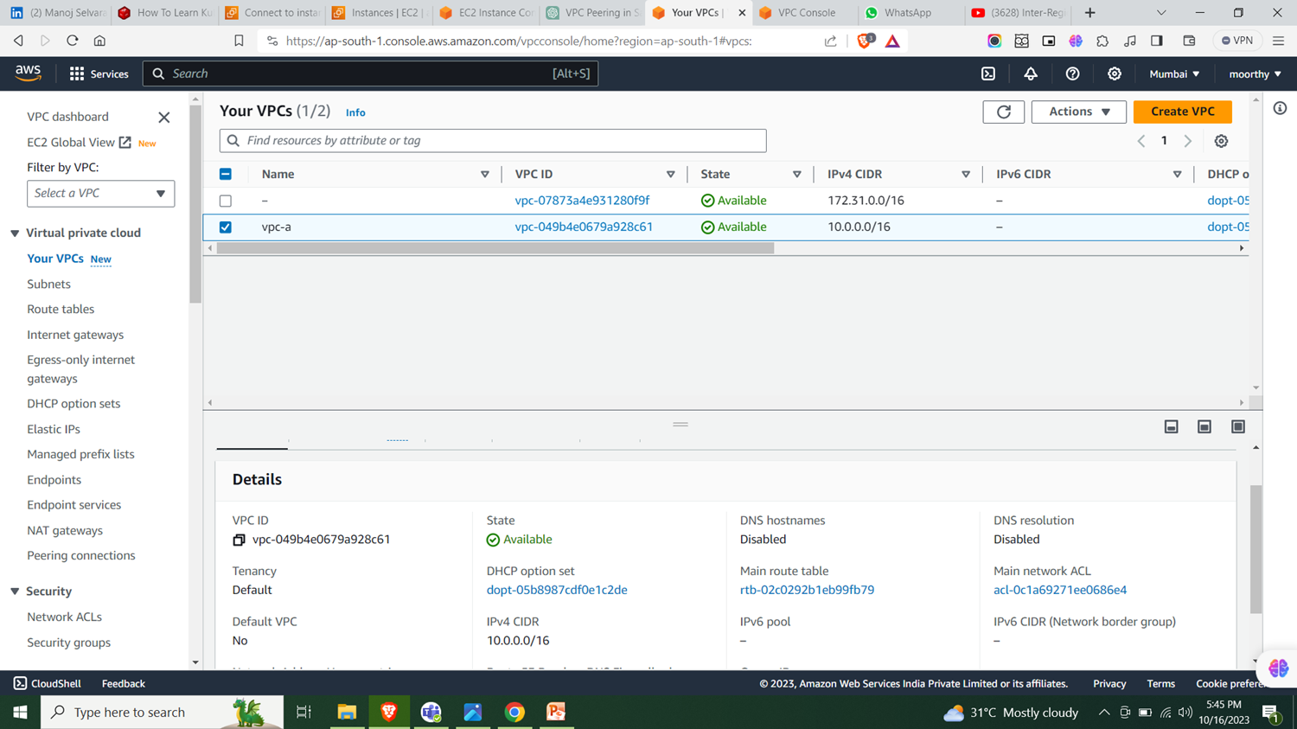
Vpc for ap-south-1 region

Slide 4
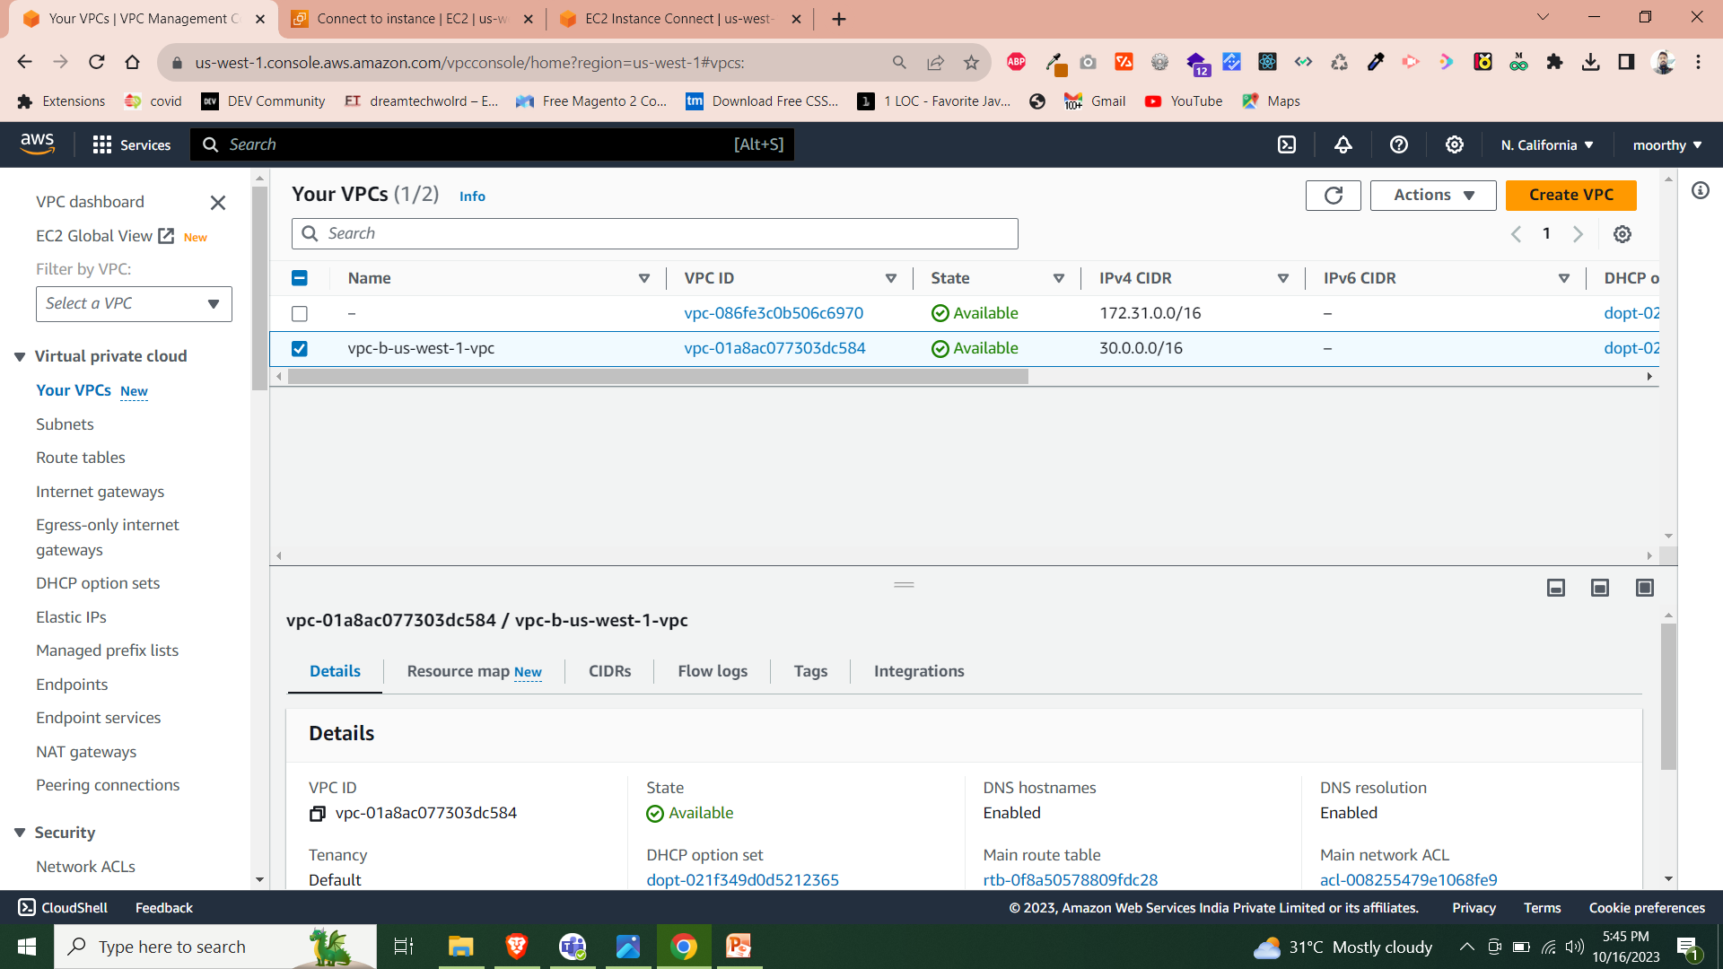
Vpc for us-west-1 region

Slide 5
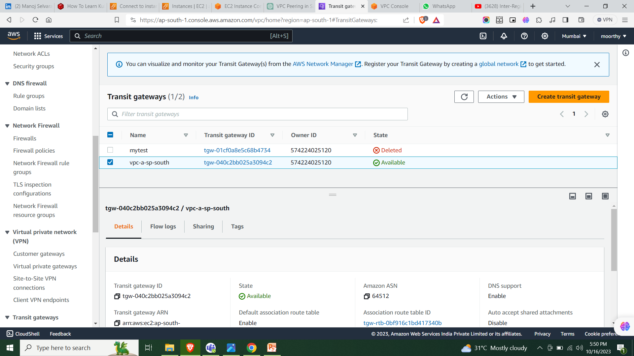
Create transitgateway ap-south-1

Slide 6
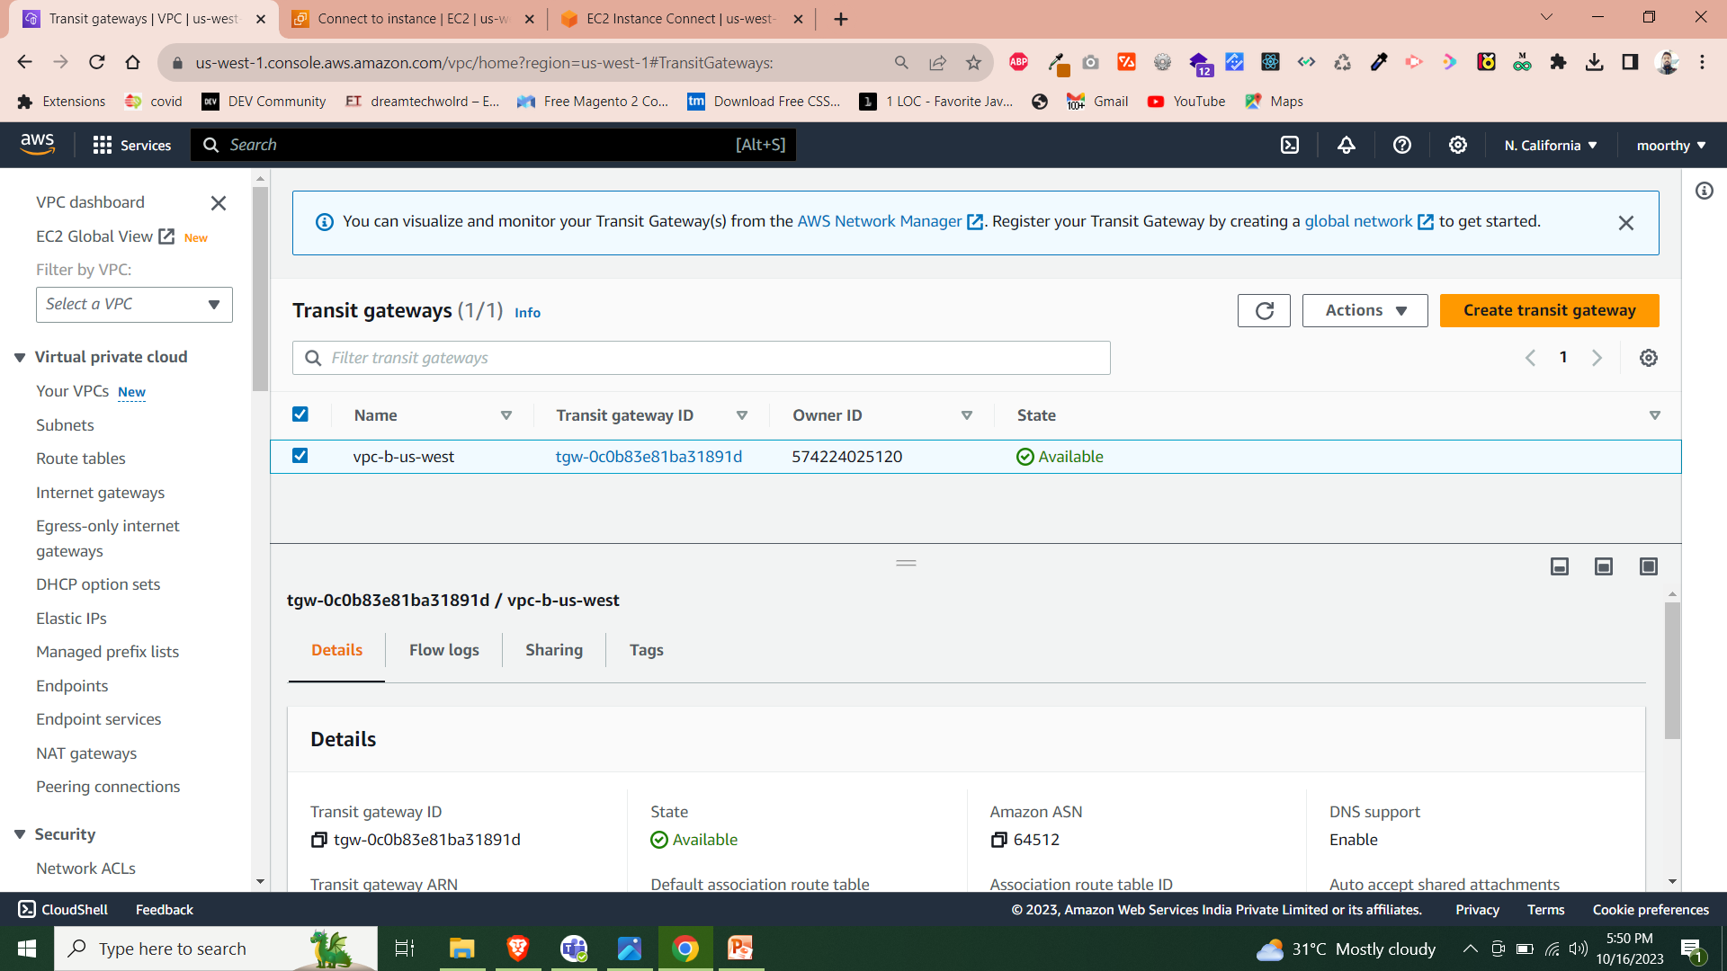
Create transitgateway us-west-1

Slide 7
3. Transitgateway policy ap-south-1
TGW Policy – peering
Select Tgw id, choose peering region, peering region TGW id
TGW Policy – Vpc
Select tgw id, choose vpc same region, select Vpc id
Same as above us-west-1

Slide 8
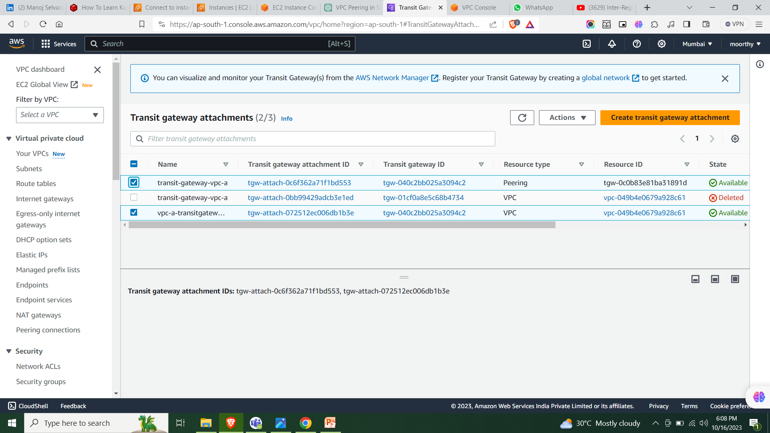

Slide 9
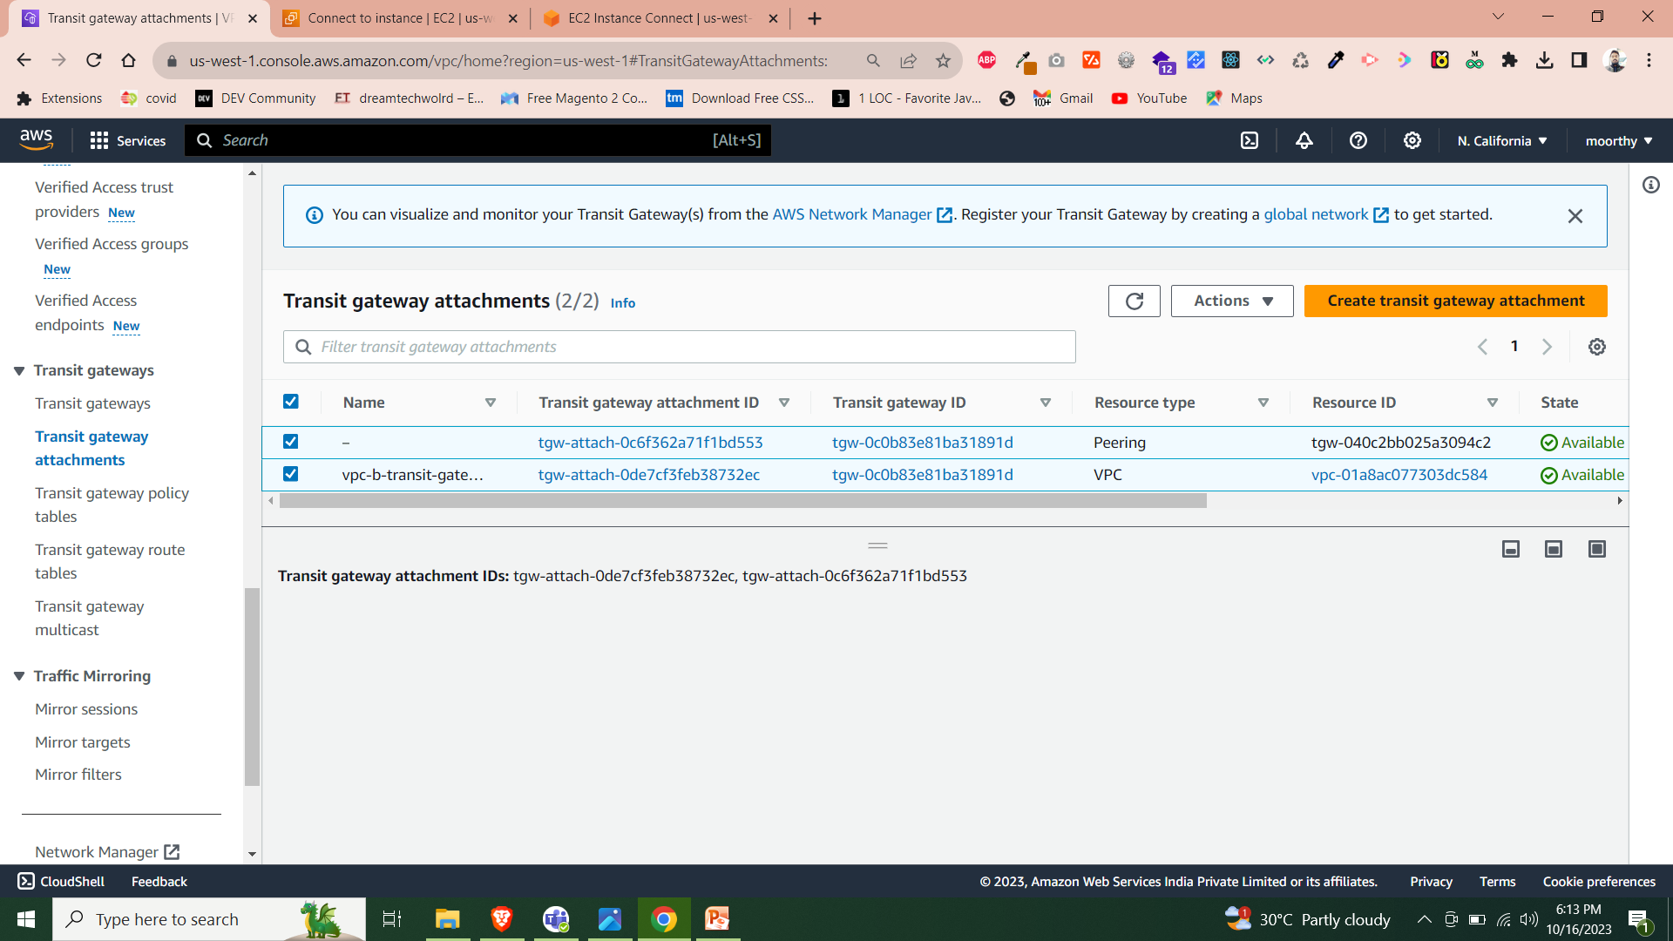

Slide 11
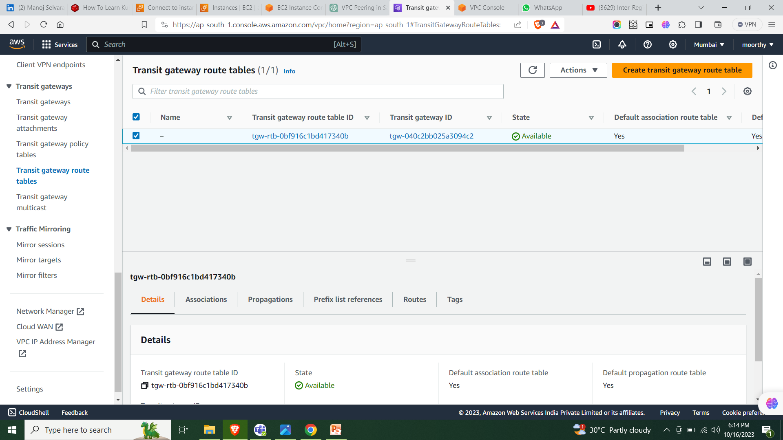
TGW Route Table ap-south-1. same as us-west-1

Slide 12
TGW Route Table ap-south-1. same as us-west-1

Slide 13
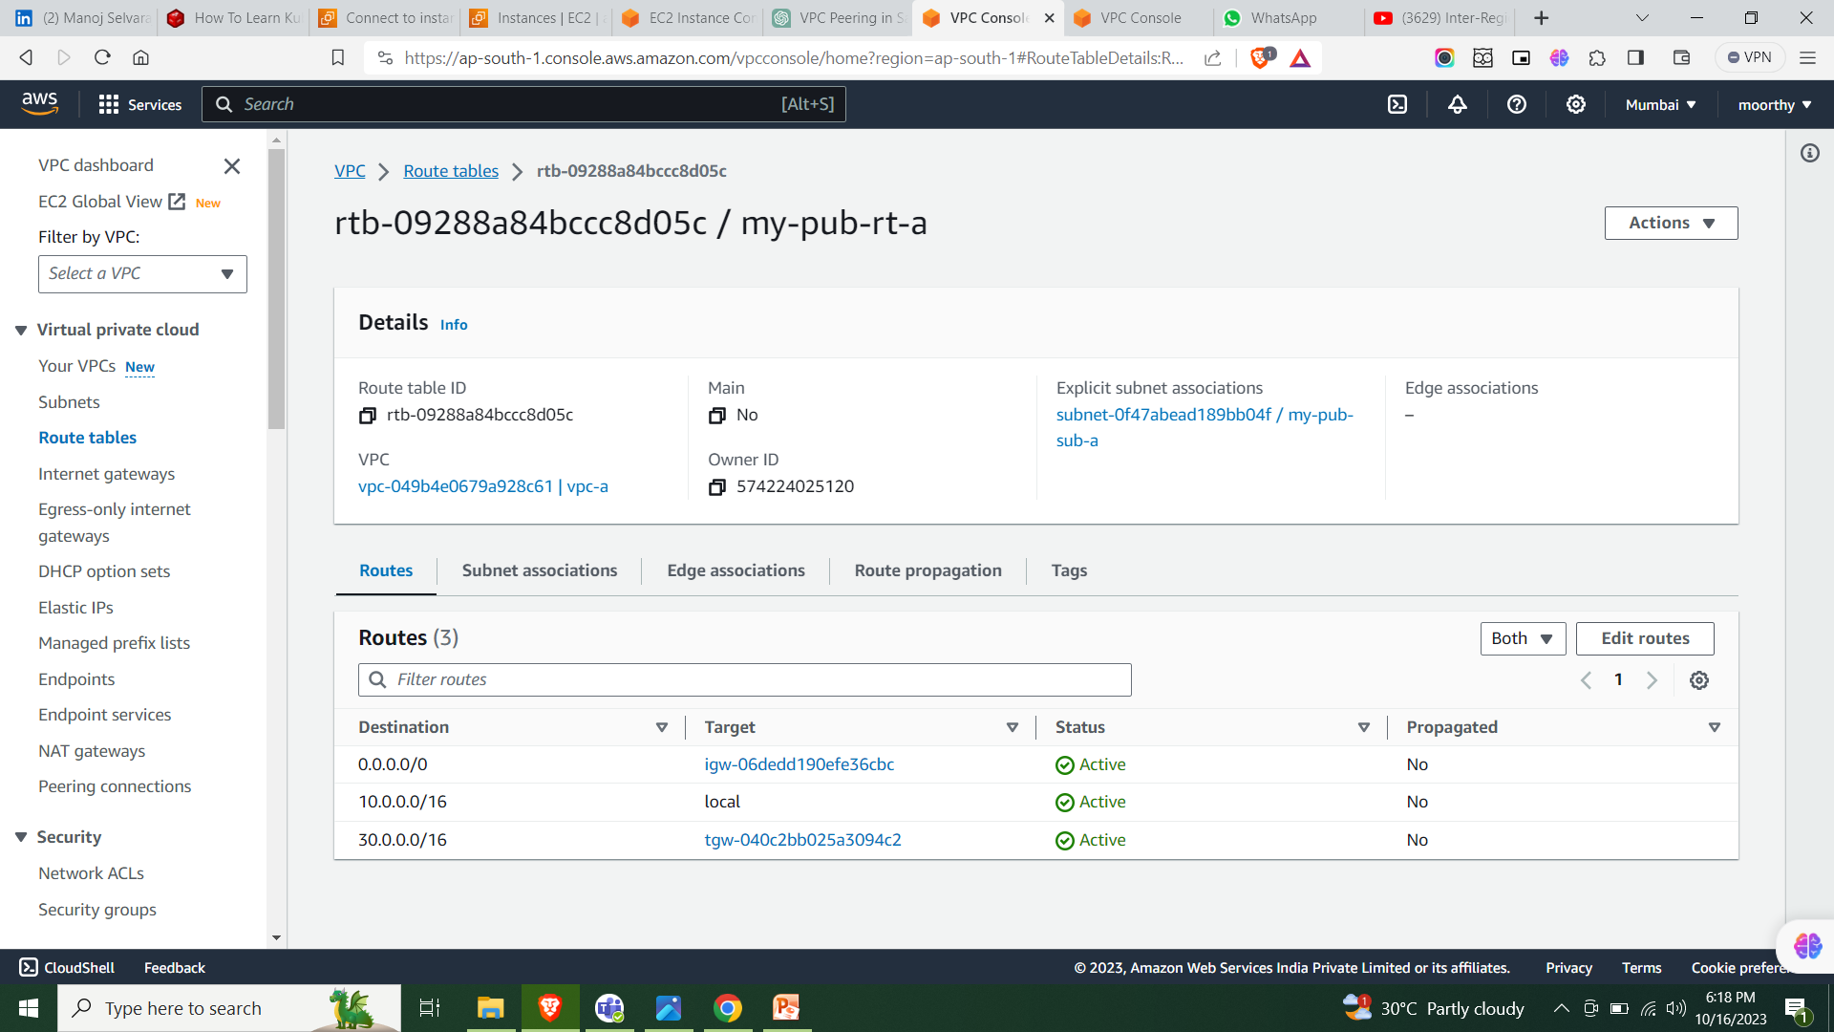
Attache Rt TGW for vpc RT –ap-south-1. same as us-west-1

Slide 14
CREATE 2 EC2 INSTANCES
1.EC2 Instance ap-south-1->choose same region vpc and pub-subnet.
2. Allow sg for icmp -> target region ip address – us-west1.
3. Same as above create ec2-instances

Slide 15
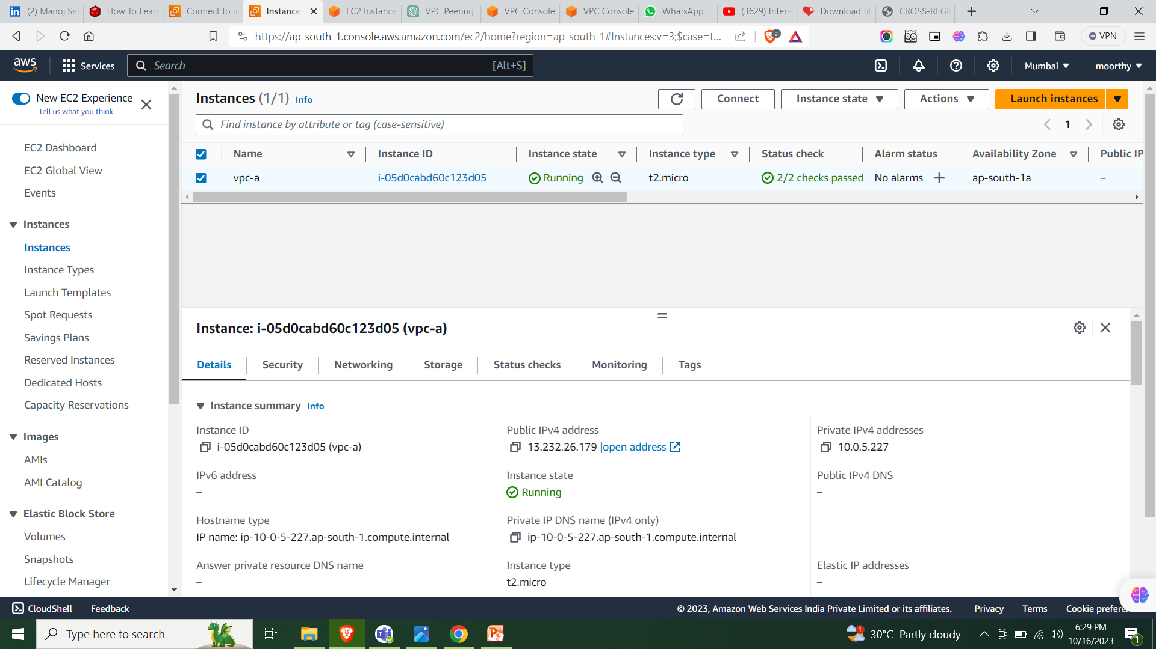
Ec2 instance ap-south-1

Slide 16
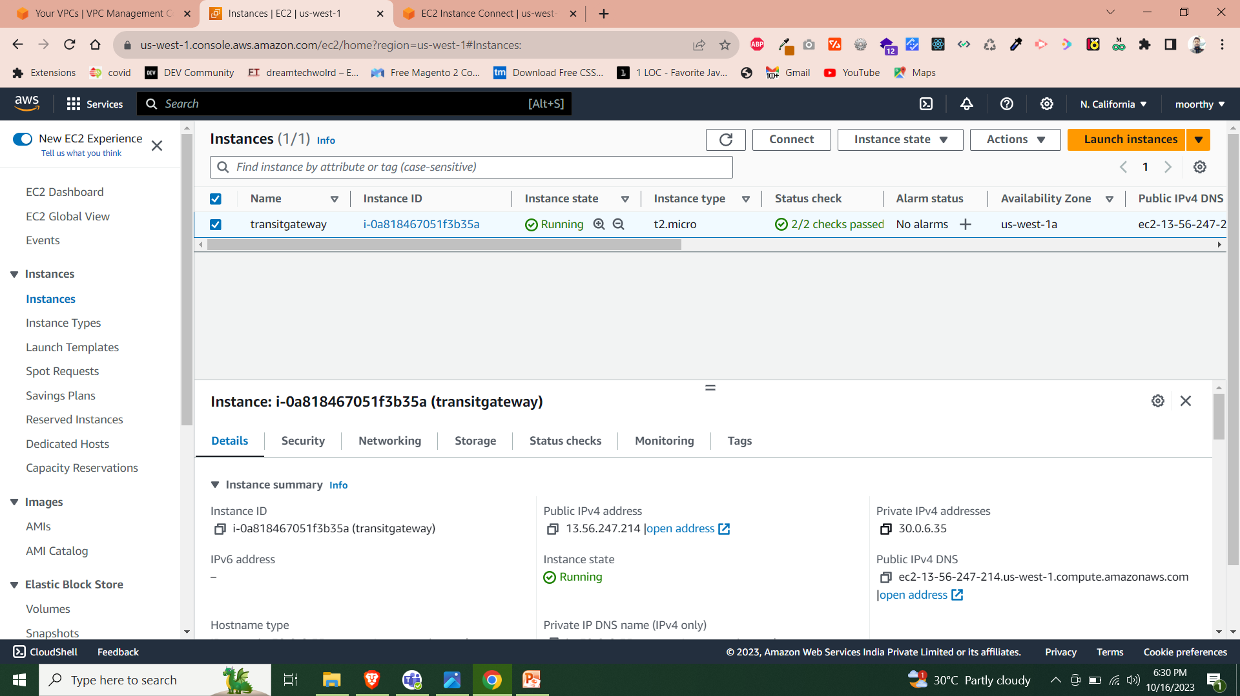
Ec2 instance us-west-1

Slide 17
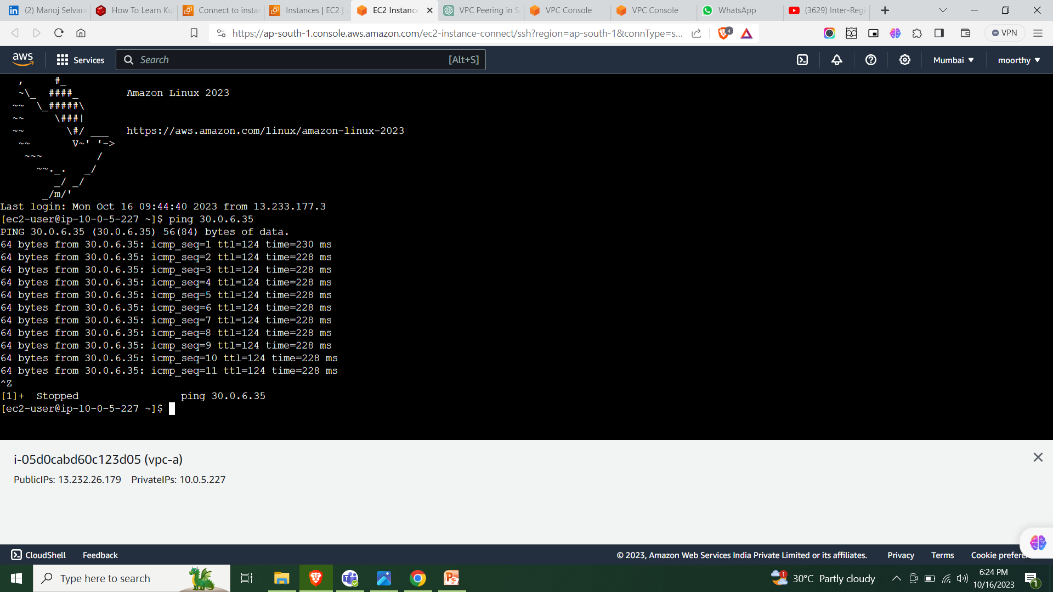
Ping privatly for ap-south-1

Slide 18
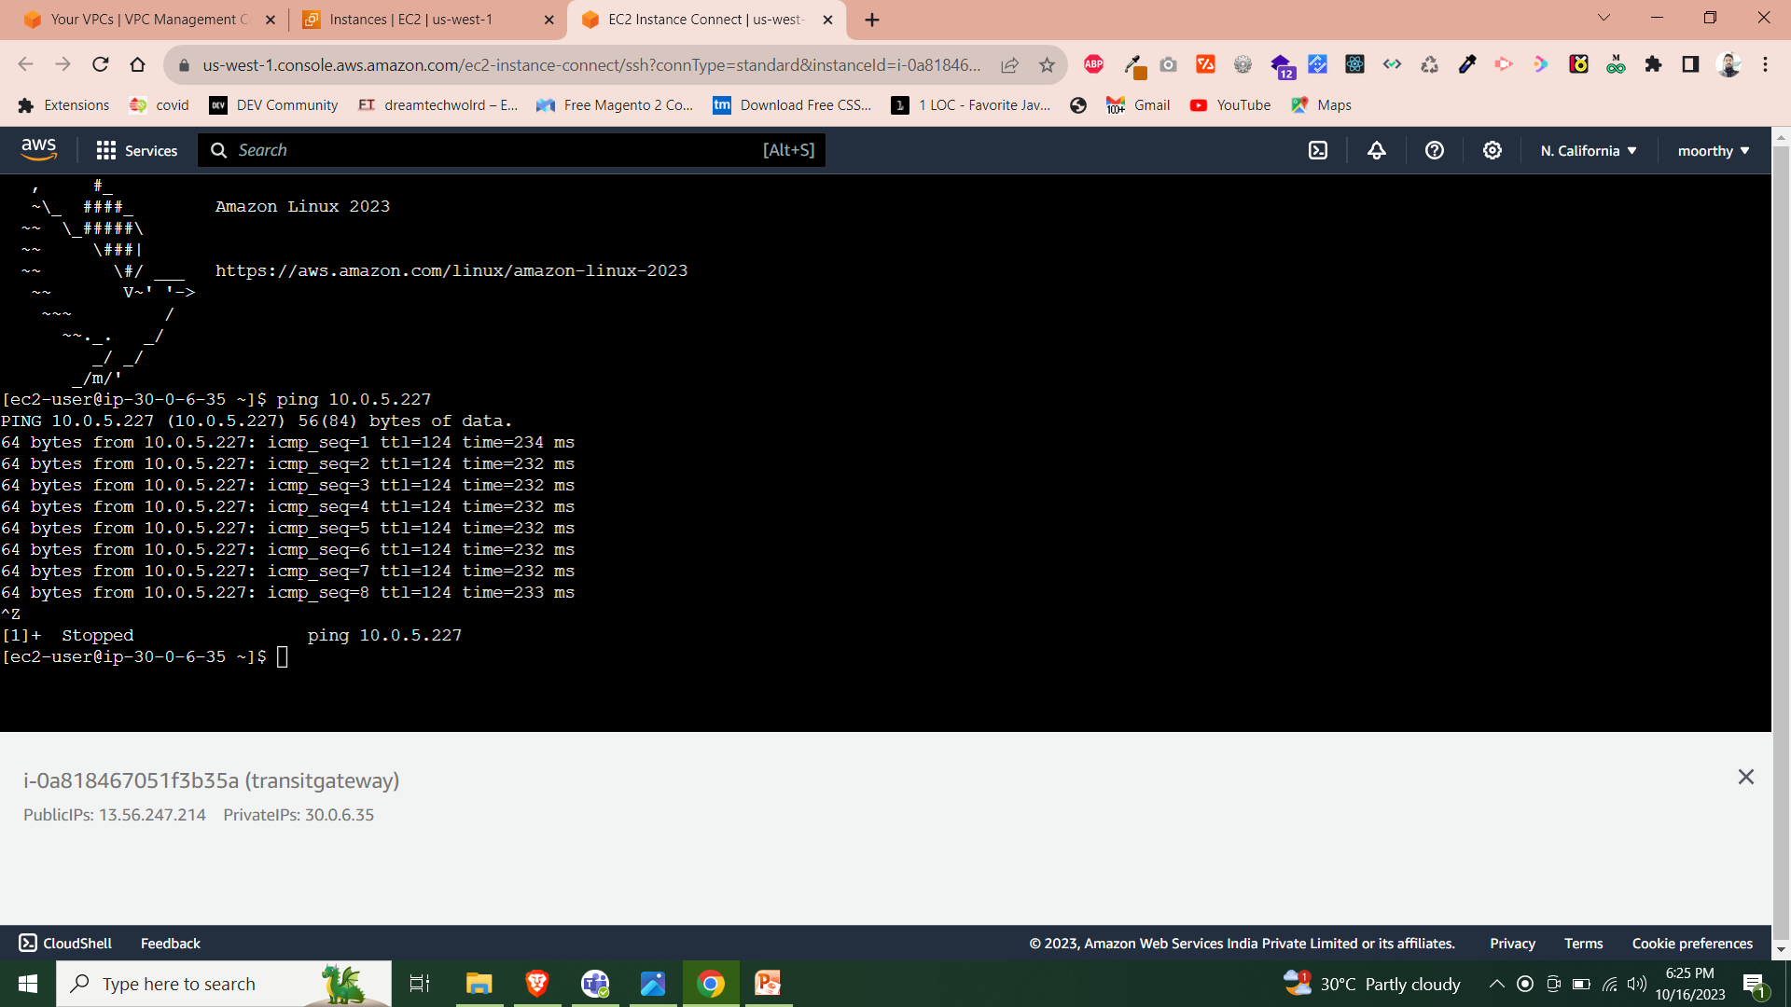
Ping privatly for us-west-1

